Slide 1
C.D.R.
Smart Surveillance Hub
By: Matthew Weinert, Korey Lombardi, Kenneth Ancrum, Joshua Sherrill
Group 15

Slide 2
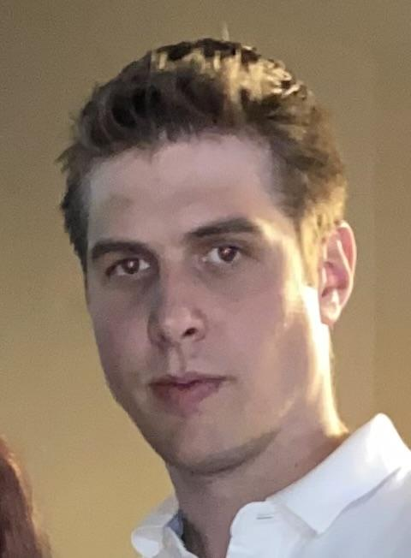
Overview
Project rundown
Product Comparison
Hardware overview
Electrical Schematic / Design
Software
Front and backend software
Budget
Roles & Responsibilities
Future Tasks
Questions

Slide 3
Our Team
Matthew Weinert CPE - Frontend/Backend Developer
Korey Lombardi CPE - Firmware/Backend Developer
Kenneth Ancrum EE - Hardware/Firmware
Joshua Sherrill EE - Hardware/Firmware

Slide 4
Our Project
The smart hub at its core functionality is a smart detection system, where users can purchase any IP camera off the market and connect it directly to the hub.
The hub will use smart detection technology to alert the user when someone is in the view of the camera by an alarm and changing led lights.
The goal of this project is deliver a functioning smart detection system.

Slide 5
The Problem/Motivation
Do it yourself security is expensive and there are little options on the market for a full security system that can be self monitored.
Home Security companies gouge customers with subpar products because of lack of competition.
Lack of flexibility when it comes to a home security system.
Lack of features, such as Detection software and 3rd-party peripheral compatibility.

Slide 6
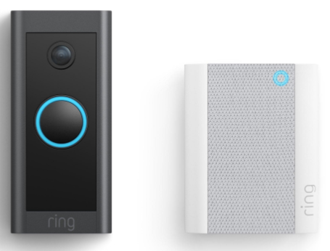
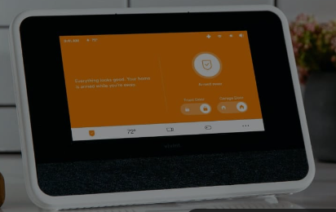
Similar Products
The most popular products that are similar to our project include
Ring
Arlo
Vivint
ADT
Similarities
Differences

Slide 7
Stretch Goals
Objectives/Goals
Main Goals
Advanced Goals
To have a functioning trained AI detection system
To have a functioning user application to navigate our system
Deliver a noticeable notification system (visual and sound)
Video Control Features
Fast Forward
Rewind
Play/Pause
Multi Camera Capability
Different Tones
Cloud Storage Capability
Mobile Application
Backup Battery
Adding increased range of IP cameras supported
Ability to cast and receive data
2 way communication via the hub and the camera
Screenshot Capability

Slide 8
Specifications and Requirements
The Smart Surveillance needs to meet these standards:
Total Hub weighs 5 lbs or less
Speakers produce sound at 80 dB or more
System connects to cameras in less than 5 seconds
System Detects people within 5 seconds of entering frame

Slide 9
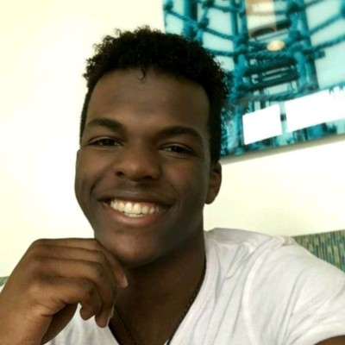
Hardware

Slide 10
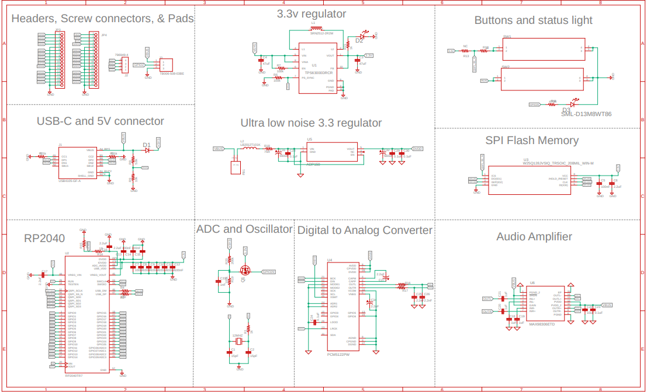
Overall EAGLE Schematic

Slide 11
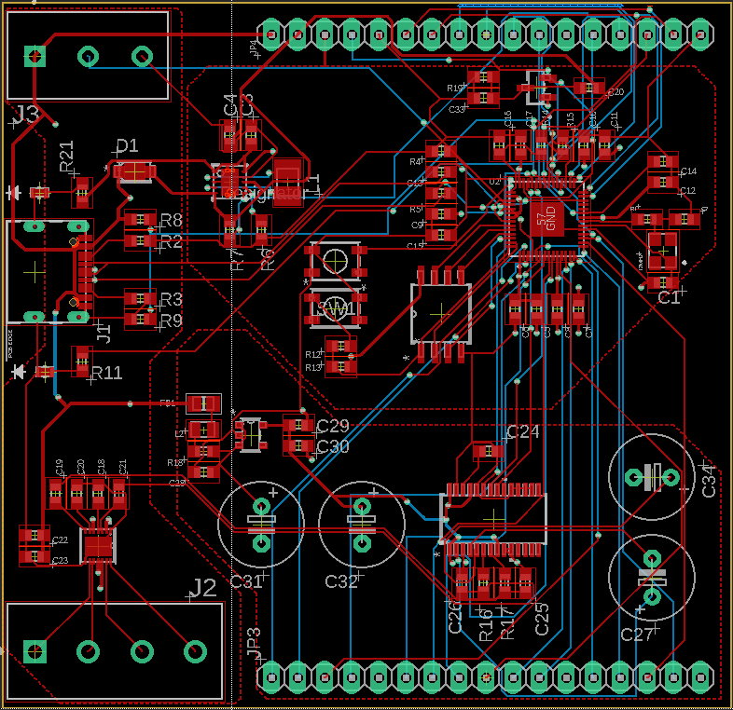
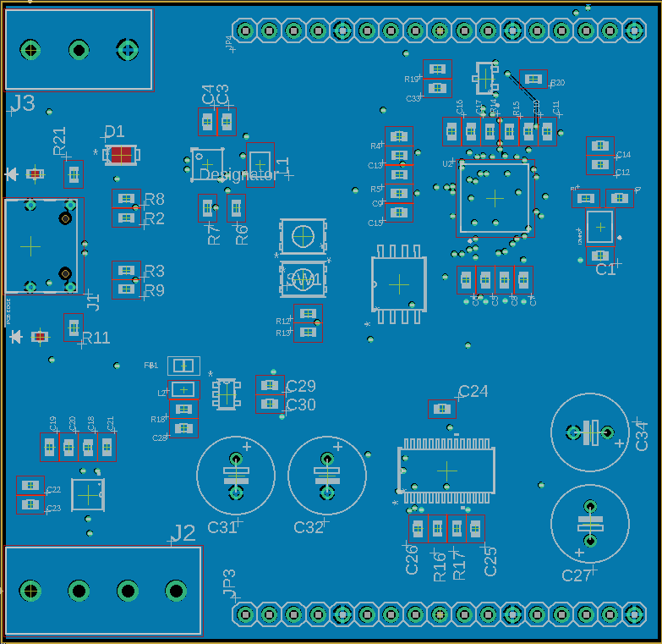
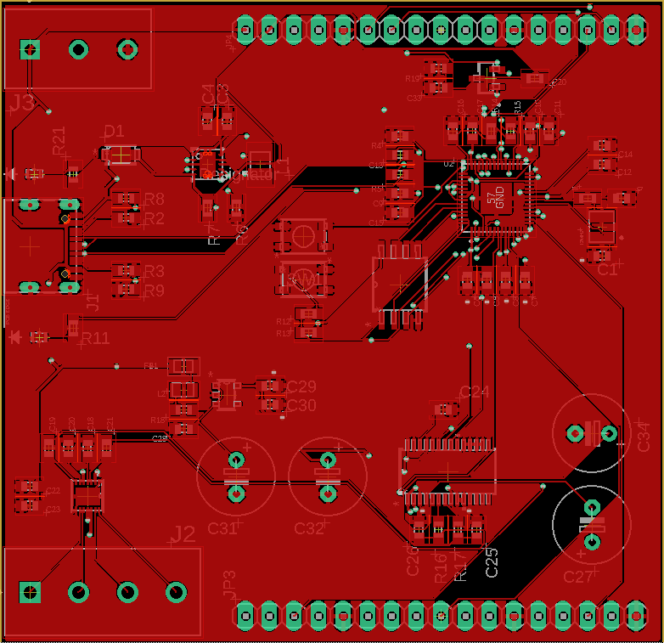
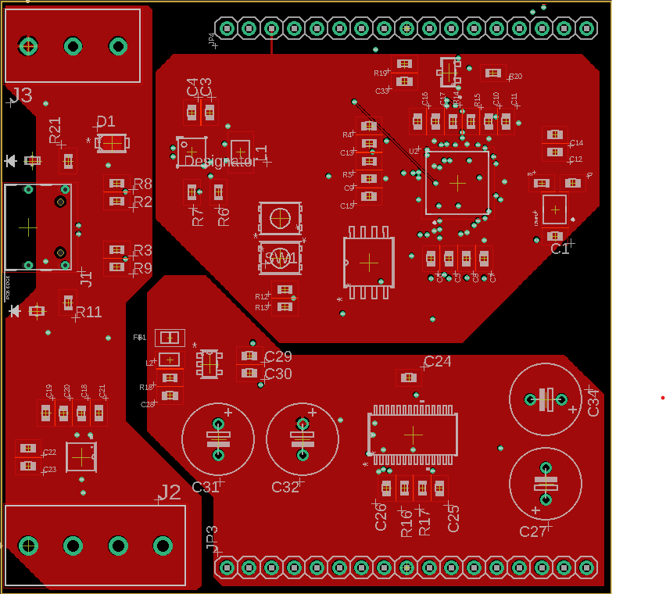
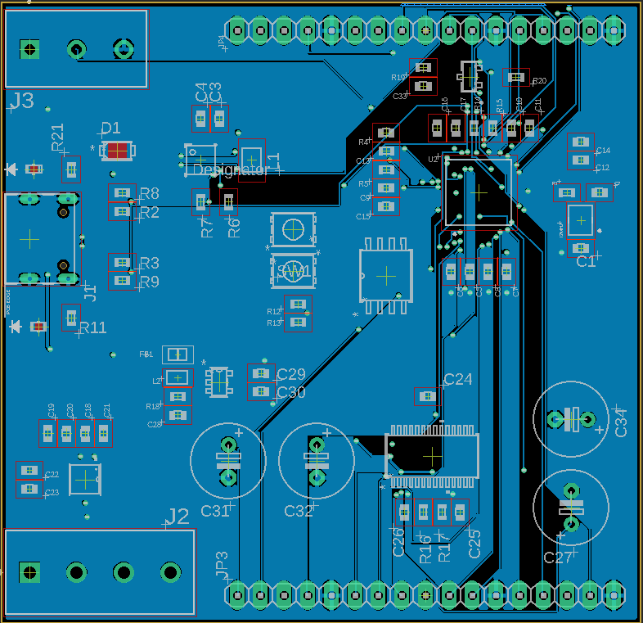
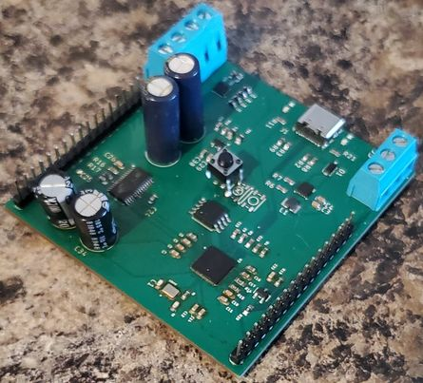
PCB Layout/Design
Final assembly
Trace/signal lines
GND layer
Four layer board design
1 oz copper weight
Trace width measured to handle current for different voltage currents
PCB size: 69X67mm
Top/signal layer
Power layer
Bottom/signal layer
Final assembly

Slide 12
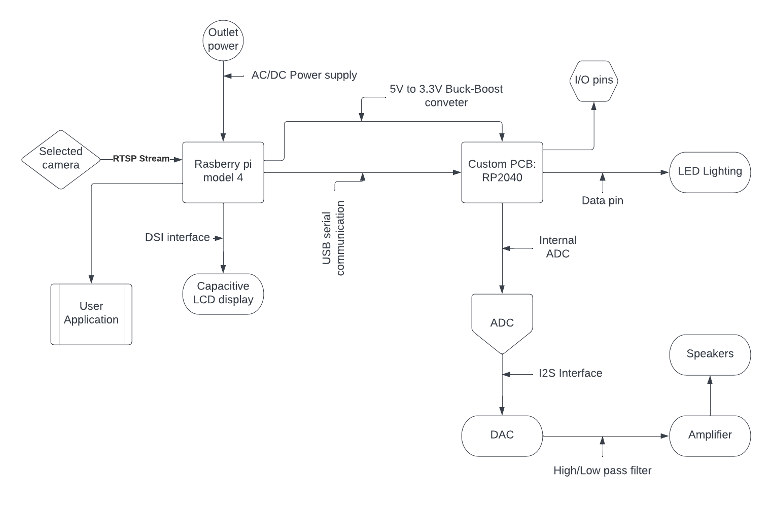
Hardware Diagram
Raspberry Pi 4
Responsible for higher computation, front and back end software, driver for the main display, and communication with our Custom PCB. we chose the raspberry pi as it come feature with expansion header at offers 64-bit SoC @ 1.5GHz.
Custom PCB (MCU)
Back end software as well as sound and lighting peripherals, Low noise and Low power designed for constant usage
Low profile sizing
Designed for mobility and lower power usage making compatibility in smaller settings easier

Slide 13
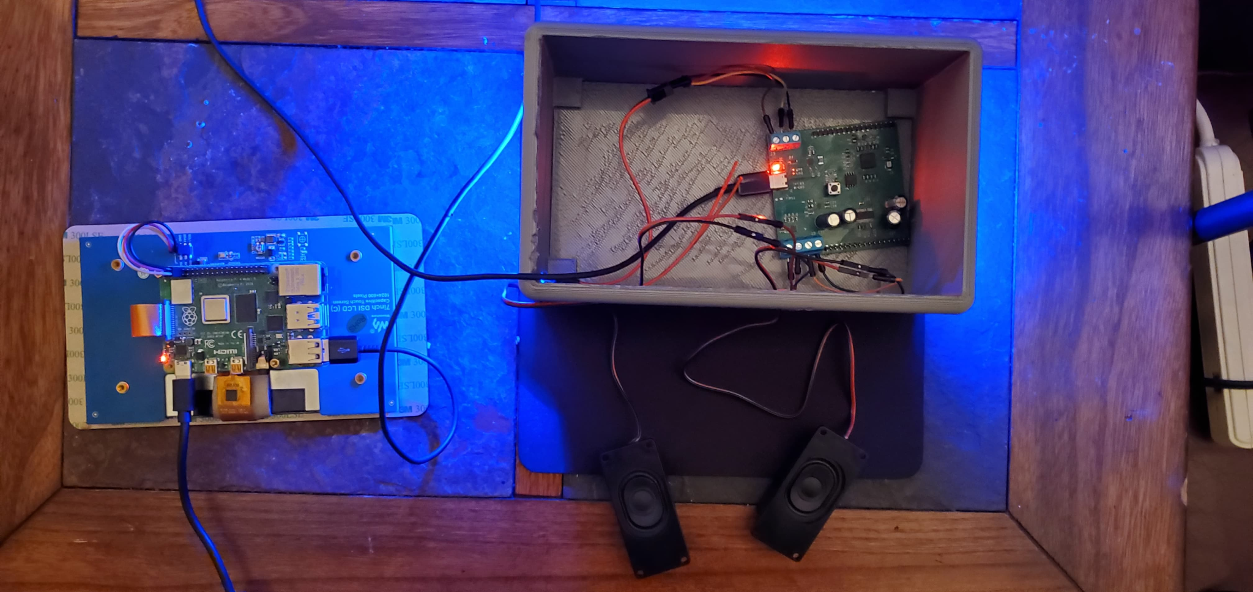
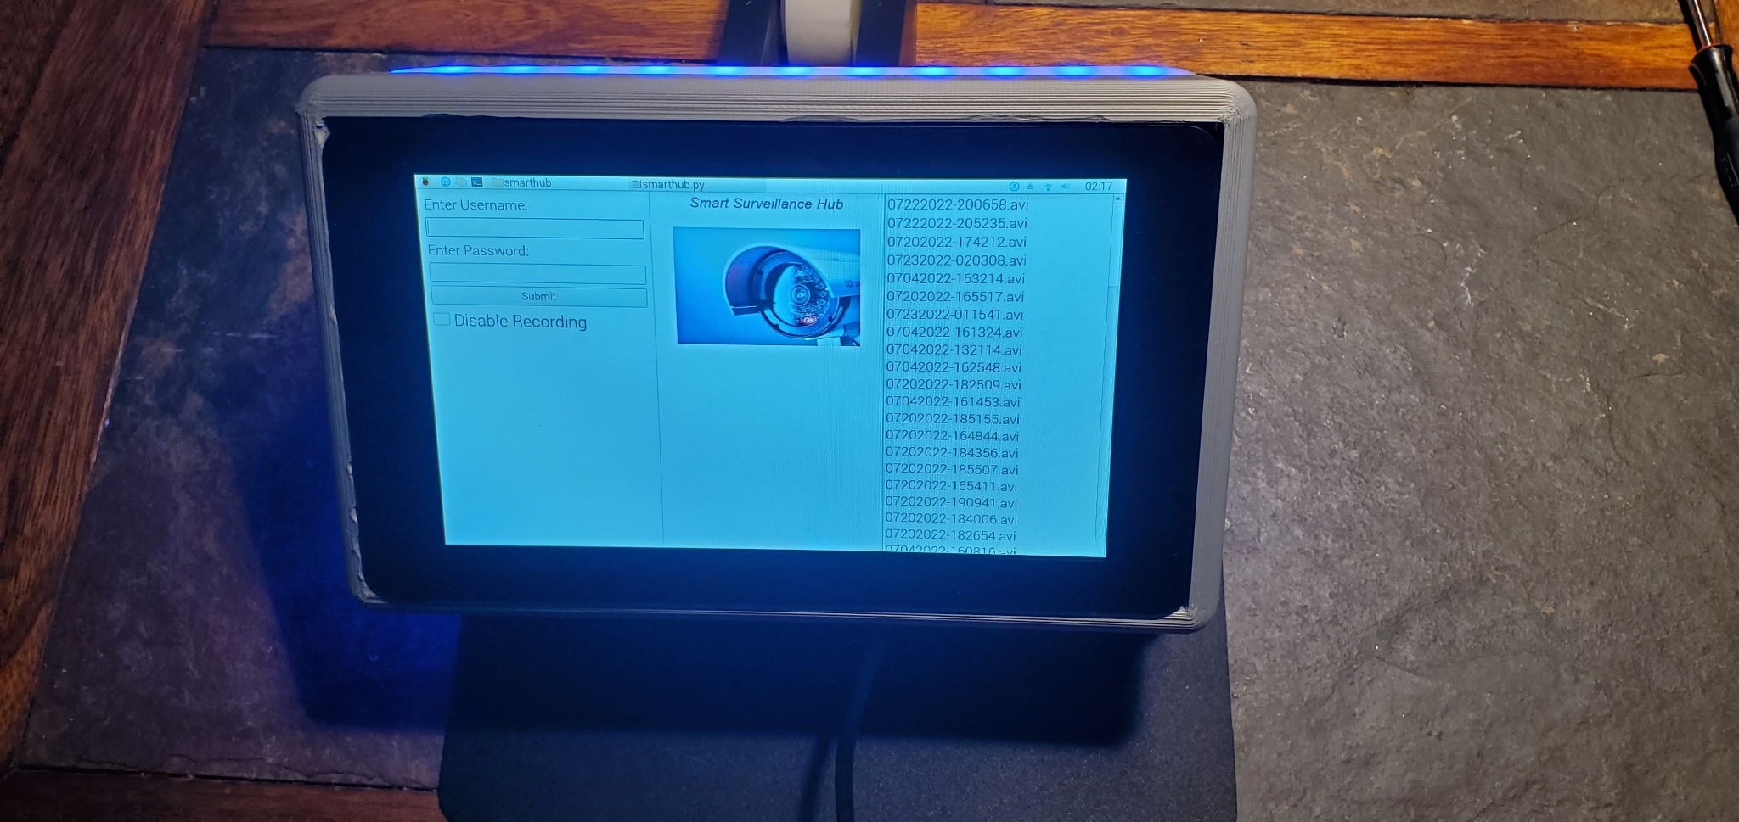
Full system/Hardware build

Slide 14
Microcontroller options
RP2040 | ATmega 32 | ESP-S3
Dual-core Arm Cortex-M0+ | low-power 8-bit AVR at 16Mhz clock speed | Dual high performance Xtensa® 32-bit LX7 CPU cores
264KB on-chip SRAM | 2 Kilo bytes of internal Static RAM | Ultra Low Power co-processor
8 × Programmable I/O (PIO) state machines | 8 Channel, 10 bit ADC | Wi-Fi (2.4 GHz band)Bluetooth Low Energy
Low-power sleep and dormant modes | 32 Kilo of on board flash memory | Lots of library support
Unit price- $1 | Unit price-$6.66 | Unit price- $1.85
Sought after specifications
Selection Parameters
Fast clock speeds
Onboard Analog to Digital Converter
Plenty of GPIO pins
extensive library support

Slide 15
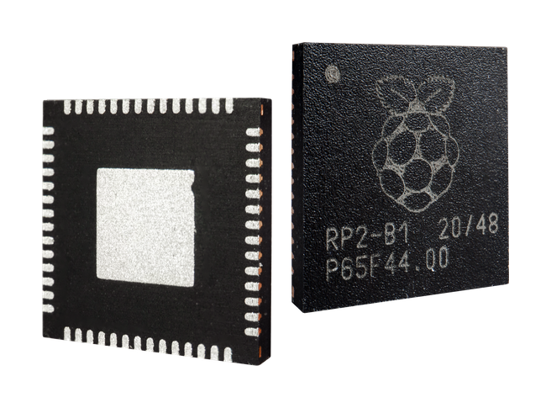
RP2040
Microcontroller
Chosen for………
Dual-core Arm Cortex-M0+ processor, flexible clock running up to 133 MHz
Has support for popular IDEs, such as Visual studio, Arduino, and Thonny
Low power modes
Large community support on the Raspberry Pi platform
PIO state machines for custom peripherals
And ability to supply flash memory up to 16MB for boot rom

Slide 16
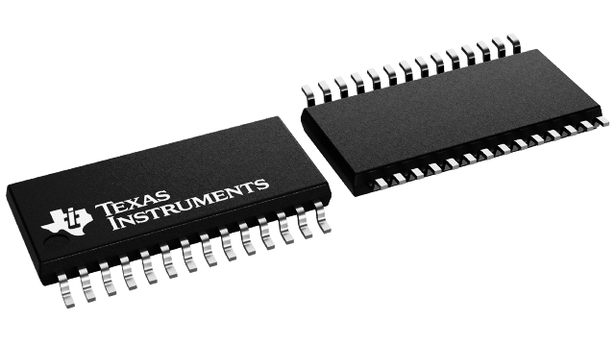
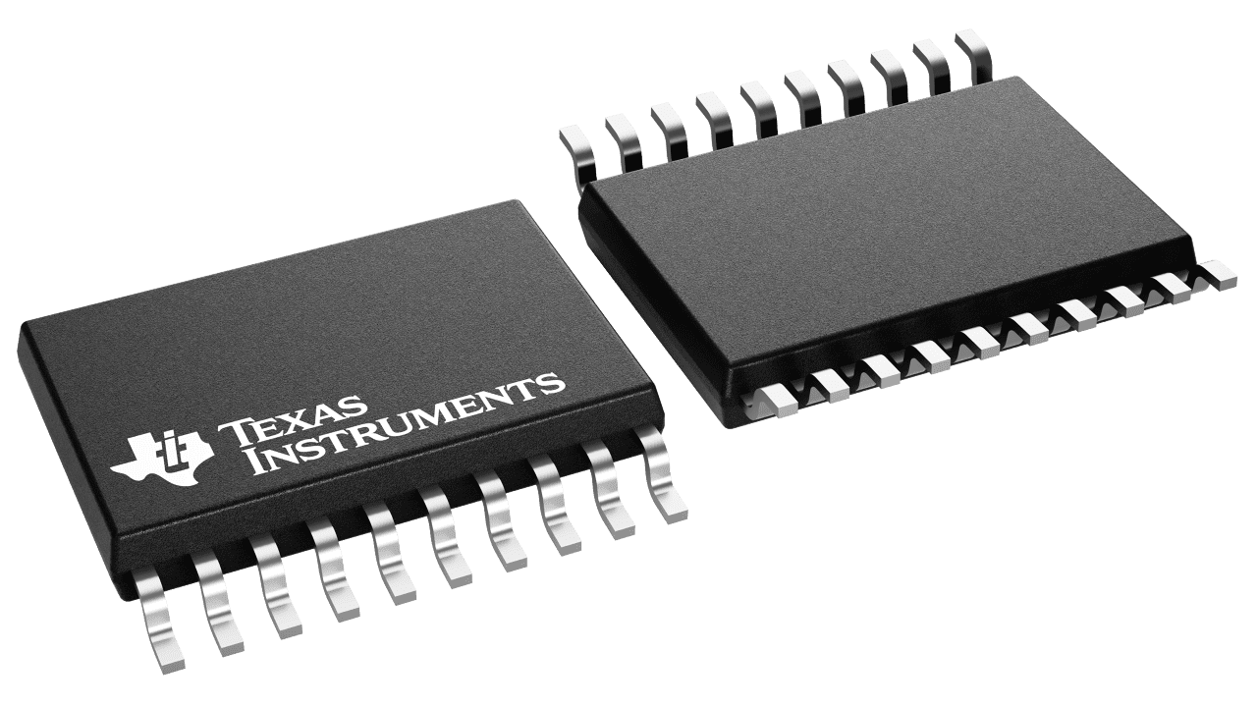
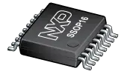
Digital to Analog Converter
PCM5122 | PCM5102 | UDA1334ATS
Software and hardware configurable for I2C,I2S,SPI | Only hardware configurable | Only hardware configurable
Integrated PLL to drive system clock | Integrated PLL | Integrated PLL
Accepts 16-, 20-, 24-, and 32-Bit Audio Data | Accepts 16-, 20-, 24-, and 32-Bit Audio Data | Accepts 16-, 20-, 24-
dB rating 112 | dB rating 112 | dB 100
Unit price- $3.10 | Unit price-$2.59 | Unit price- $2.84
Sought after features
PLL Clock Generation
Without the presence of a Master clock we can still operate in I2S interface form simple quality sound.
Volume Control
allows for digital controls such as Volume control and automute functions.
Support for standard interfaces
has three modes two of which allows for I2C and SPI making programming and firmware implementation super simple.

Slide 17
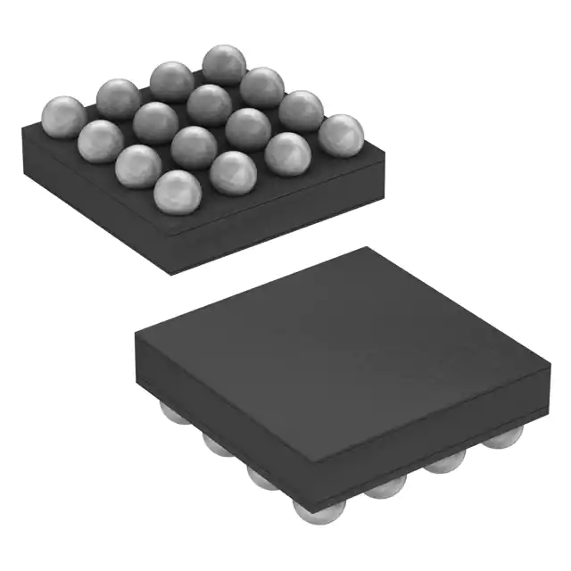
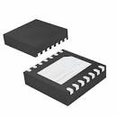
Amplifier
Sought after features
Pop suppression
During startup, the click-and-pop suppression circuit reduces any audible transient sources internal to the device.
Class D or AB amplifier performance
Gives Class D/AB performance, for which MOSFETs) operate as electronic switches, and not as linear gain devices as in other amplifiers.
MAX98306ETD+T | MAX98303EWE+T
Output Power 3.7W at 3Ω with 5V Supply | Output Power 3.1W at 4Ω with 5V Supply
Click-and-Pop Suppression | Click-and-Pop Suppression
Class D Speaker Amplifier | Class D Speaker Amplifier
Gain selection | BGA package type
Unit price - $2.33 | Unit price - $2.15
Notes:
When entering shutdown, the differential speaker outputs ramp down to PGND quickly and simultaneously

Slide 18
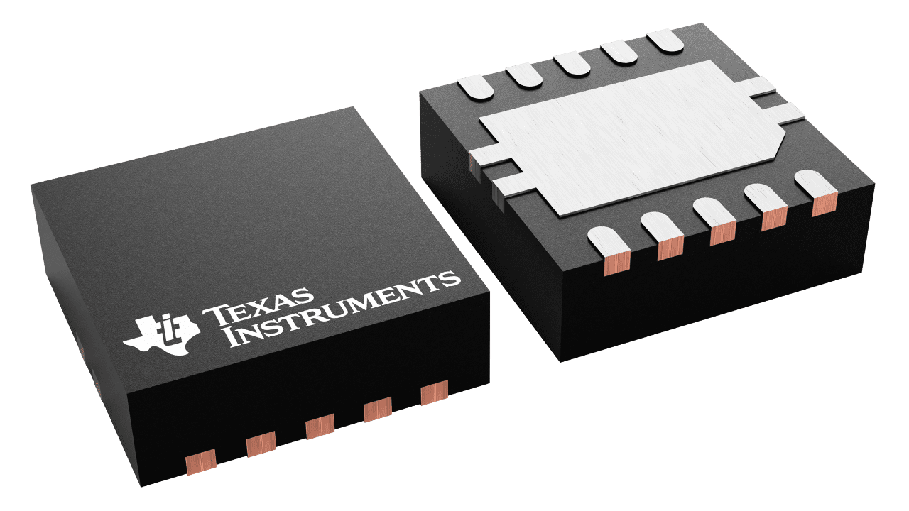
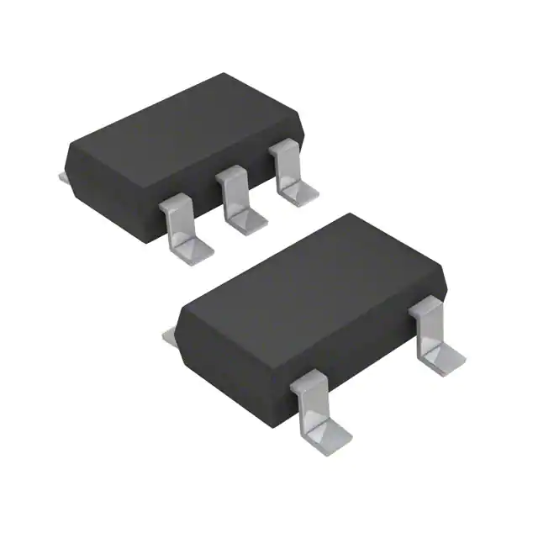
Voltage Regulators
Sought after specifications
TPS63000 | TPS63001 | ADP150
Output currents can go as high as 1200 mA | Output currents can go as high as 1200 mA | Input voltage range: 2.2 V to 5.5 V output 3.3V
Voltage supply range 1.8V-5.5V output max 5.5v | Voltage supply range 1.8V-5.5V output max 3.3v | Maximum output current: 150 mA
Power-Save Mode for Improved Efficiency | Power-Save Mode for Improved Efficiency | Ultralow noise: 9 μV rms
Unit price-$1.73 | Unit price-$1.73 | Unit price-$1.36
Can output at least 600mA at 3.3v for our MCU
Low EMI
Low power functionality
At least 150-200mA for DAC unit
Notes:
Frequency Synchronization, Light Load Efficiency,

Slide 19
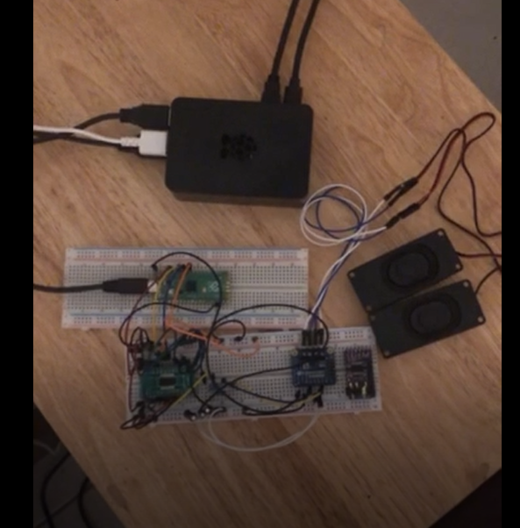
Prototyping For DAC
Initial prototyping was done using a raspberry pi pico to test the I2S interface connection with the PCM5122. This helped us to understand the sound function in our system.

Slide 20
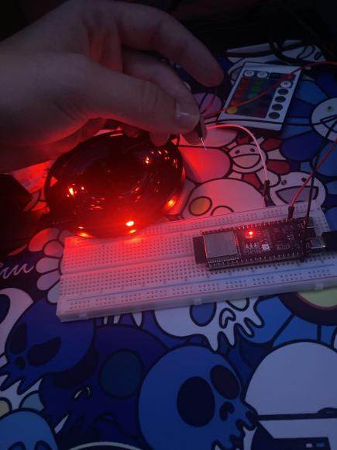
Prototyping For Lighting
Using the pico,esp32, and atmega32 development boards we tested programming for 4 wire and 3 wire led strips, to helps us in choosing the most efficient choice.

Slide 21
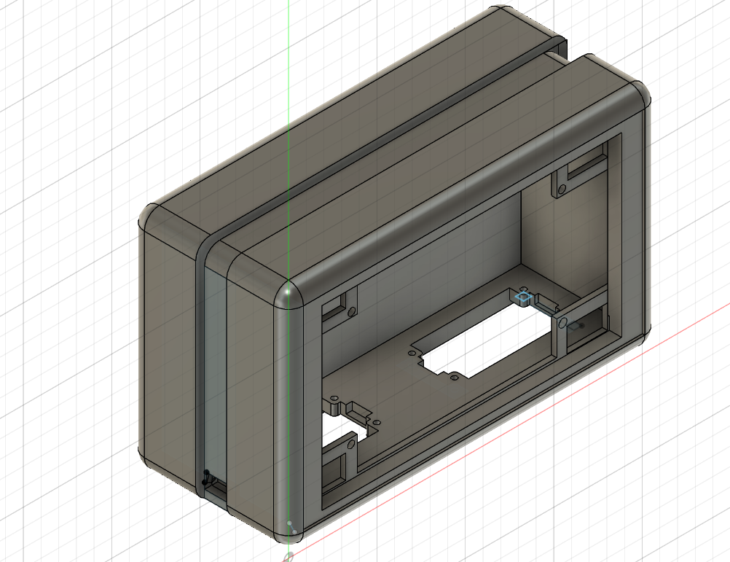
3D Modelled Case
This light weight designs provides all the stability needed for holding the PCB, LCD screen, Speakers, and light diffuser with LEDs inside. This design features a removable back with easy assembly.

Slide 22
Problems & Solutions
Current issues
Reference oscillator isn't a higher enough frequency, selected audio file have to be resampled
The RP2040 is new, lacks a proprietary IDE, and therefore has uncommon library support
Software and GUI issues related to design and implementation
Possible solution
Code for no standard clock timing software, provide an standard external oscillator, or select a MCU that has a high reference clock oscillator
Coding around obscure libraries using logic our recontextualizing existing programs to fit our scope
Researching and seeking python support for our GUI or finding another language to write our GUI in
Notes:
During testing we ran into some problems, most noticeably with sound
Although the I2S interface is is simple in wiring, it can generate clocking issues with the pcm5122s PLL
when there is not system or master clock the PLL reads the Bit clock, and the Bit clock is being read from the RP2040 reference clock which is only 12MHz
This is causing sample rate issues requiring us to resample any standard file we use
solutions included Writing code for higher clock timing in software wich would allow us to use an external clock
or simply running a higher clock MCU
Other issues involved the overall support for the RP2040 although the raspberry pi community has worked heavily on the RP2040 it is very new and does not have a native IDE
Luckily we found very helpful libraries and were able to design around them
Another issue came with gui development in python,
although python is an easy to code with language there isn't a lot of great Gui support when compared to other languages this prompted us to do more research into the matter, in the end we decided to stick with python and found more resources that helped.

Slide 23
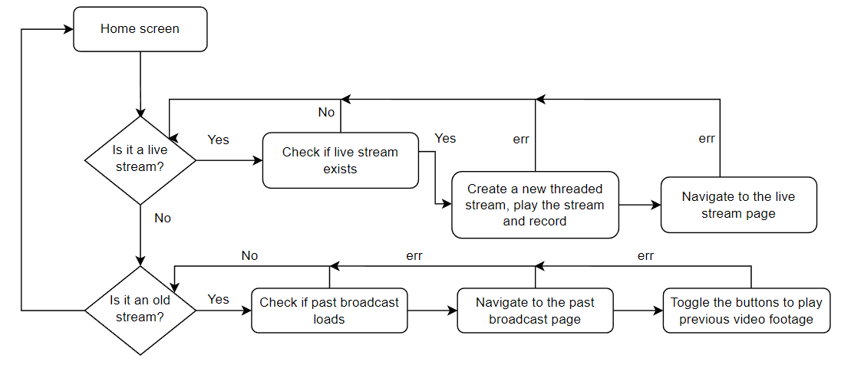
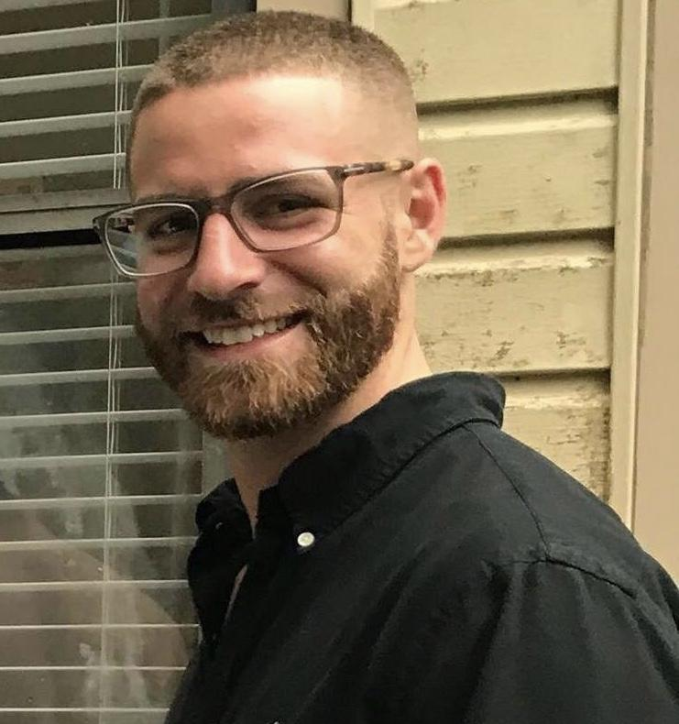
Software
Flowchart
Software Diagram

Slide 24
Software (Application)
Software Requirements:
Desktop Application
Can interface with MCU
Support for ML human detection
Portable
Multithreaded
Achieved deliverables
Streaming live video
Saving video
Watching old streams

Slide 25
Software Stack: Node
Javascript ES6
ElectronJS
Application GUI framework
TensorFlow
Computer vision library
FFMPEG
Video streaming software
MicroPythonJS
Interfacing software

Slide 26
Software Stack: Python
Python 3.10
PYQT5
Application GUI framework
OpenCV
Video streaming software
Computer vision library
PyInstaller
Package creator
CircuitPython
Hardware communication

Slide 27
Software Stack Selection
 | Hardware Communication Libraries | Machine Learning Libraries | User Interface Libraries | Speed
Python | Many widely adopted libraries such as CircuitPython and MicroPython | Largest machine learning ecosystem providing access to libraries like OpenCV | Not much flexibility for styling and locating components | PyQT5 framework is fast and efficient due to its design
Node | MicroPythonJS not as widely adopted as MicroPython | Small machine learning ecosystem that is constantly growing | Very rich ecosystem of frontend libraries and styling capabilities | ElectronJS causes application to slow its performance

Slide 28
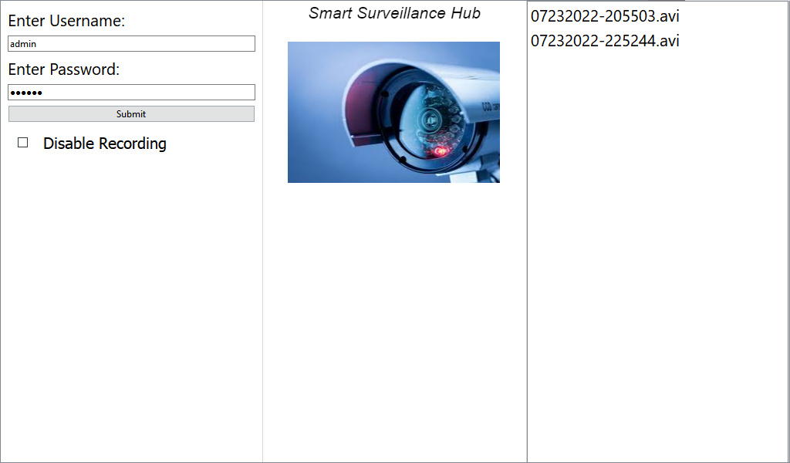
User
Interface
User Interface

Slide 29
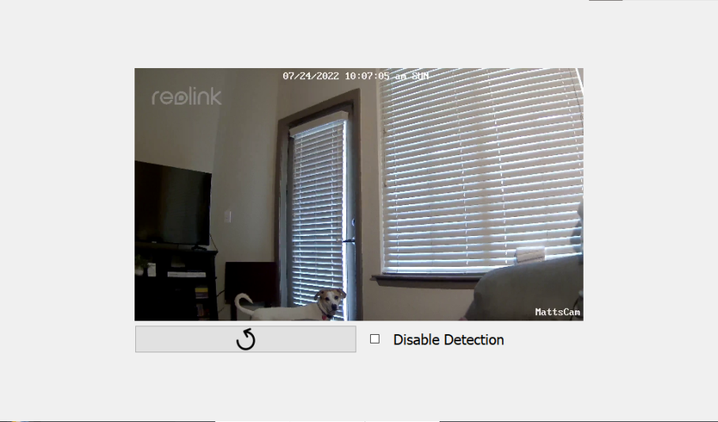
UI
Live
Feed

Slide 30
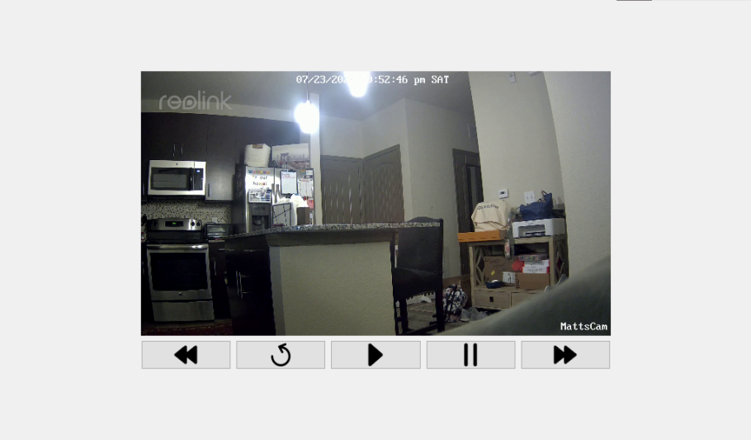
UI
Playback
Feed

Slide 31
Key Software Takeaways
Multithreaded
Each video has its own thread dedicated to the video stream, this makes the application scalable; this makes our stretch goal of multiple streaming concurrently running possible without data leaks.
Error checking
Preventing the user to input or use bad or faulty data, such as a bad RTSP url or if the camera disconnects the user’s directed back to the home page.
Portable
The Raspberry Pi O.S. is Raspbian, which is linux based and our targeted platform, but the software can also run on Windows or MacOS.
Universal
RTSP streams are universal to all IP cameras, which allows this application to easily interface with most (if not all) IP cameras.

Slide 32
Human Detection Software
Our application’s human detection capability was implemented using OpenCV, a popular computer vision library.
OpenCV provides a method named HOG (Histograms of Oriented Gradients) that’s made exclusively for detecting pedestrians.
This method works best when a person is in full view of the camera’s display with both of their arms and legs in sight.
The default parameters used for detection slowed down our applications performance. To maximize application performance we increased the winstride and scale parameters.
Consecutive detections are made for each human.
We built a timer in the software to keep the system from alerting the user everytime opencv makes a consecutive detection on one person.

Slide 33
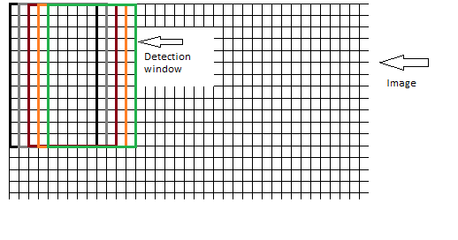
Modifying Human Detection Parameters
The camera captures each frame containing 1920x1080 pixels.
Resizing each frame to 400x225 pixels was ideal for accuracy and performance.
The detection algorithm uses a winstride technique that iterates over the pixels of each frame.
The default winstride with parameters of (4,4) was slowing down our applications performance causing the live video stream to lag.
Changing the winstride parameters to (8,8) improved application performance while maintaining accuracy.

Slide 34
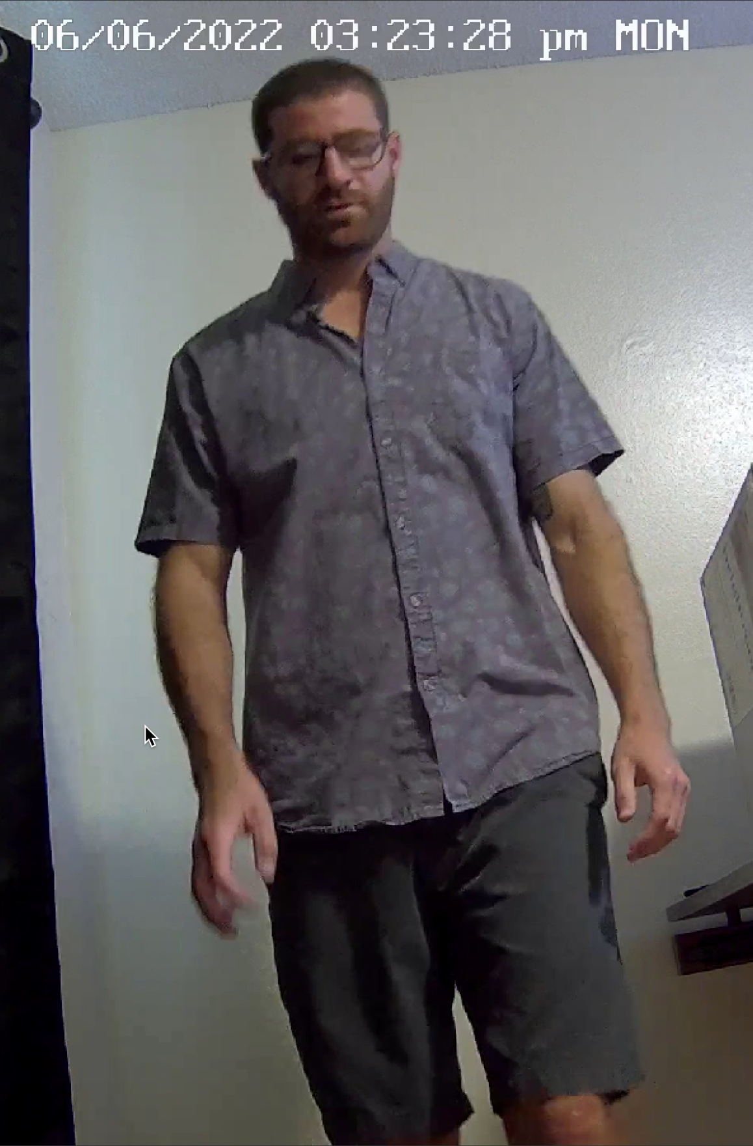
Testing Human Detection Performance
Below is a tested human detection with its output in the terminal. The numbers inside the brackets are the coordinates of where the human was found within the frame.

Slide 35
CircuitPython vs MicroPython
CircuitPython
Programming language based on Python and MicroPython designed to interact with microcontrollers.
It was built specifically for adafruit boards.
Only one file can be run at a time.
Code is executed at startup of device or reload and can’t be ran again.
Simpler but less flexible than MicroPython.
MicroPython
Python based programming language designed for interacting with microcontrollers.
Multiple files can be run at the same time allowing state to be shared.
Files can be executed more than once.
Offers more flexibility but also more complex than CircuitPython.

Slide 36
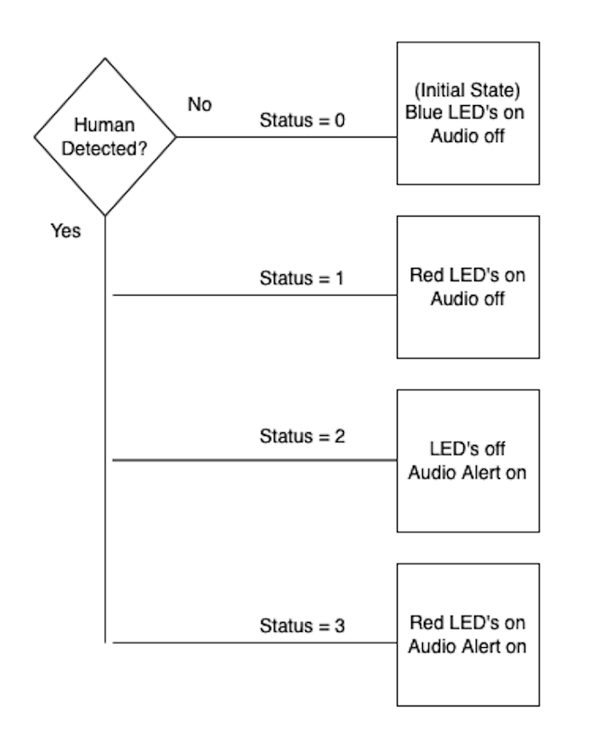
Communicating with the Microcontroller
The signals are transmitted from the Raspberry Pi to the microcontroller via UART technology.
Once the signal is received by the microcontroller, it triggers the necessary functions to activate the peripherals attached to the microcontroller.
The functionality controlling the peripherals is controlled by a single python file that’s flashed to the microcontroller.
Python file runs every time microcontroller boots.

Slide 37
Audio Playback using I2S
I2S is the standard used for digital audio communication between the Raspberry Pi Pico and the speakers attached to the Smart Hub device.
There are three necessary connections
Bit clock or serial clock
Word select
Serial data

Slide 38
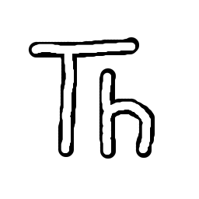
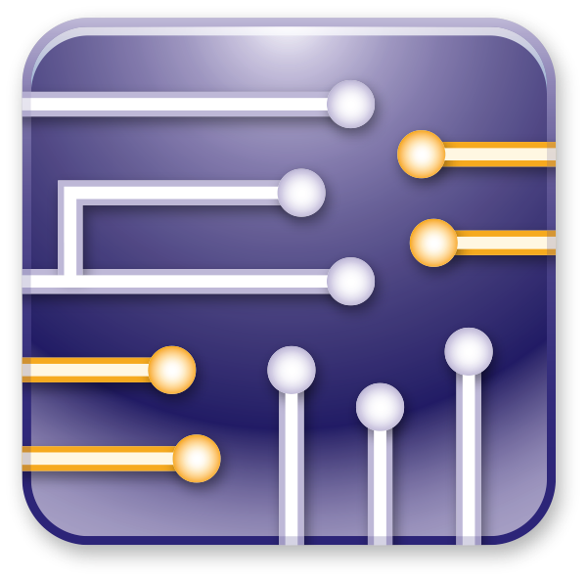
Development Environments Used
Fusion 360 & Eagle
3D modeling and ECAD schematic design
Multisim
For schematic analysis and simulation
Thonny & Visual studio
For Python and CircuitPython programming

Slide 39
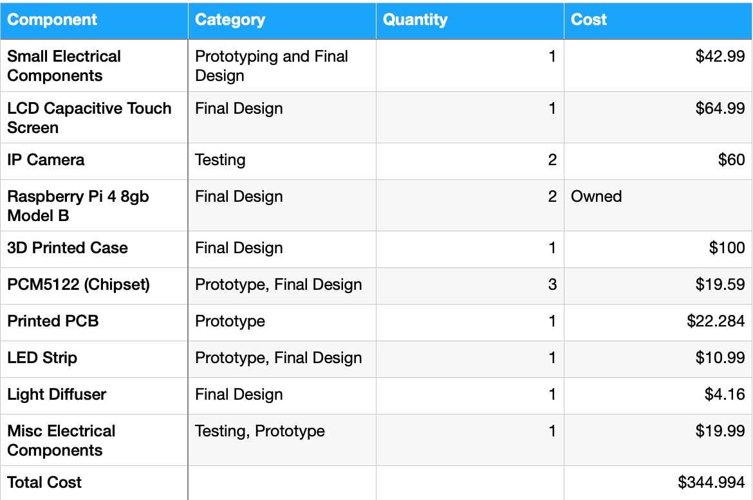
Budget

Slide 40
Roles & Responsibilities
Matt Weinert | Handle all of the user facing interfaces, such as the smart hub control features.
Korey Lombardi | Handling all of the firmware communication such as control of the LEDs and Audio.
Kenneth Ancrum | Develop the Hardware design and overall board design for custom PCB, as well as audio and power design
Joshua Sherrill | Assist with the Audio development, handle the LED design, work on the housing for the project.

Slide 41
Upcoming tasks and Future Plans
Add Additional Features (Stretch Goals)
Include more camera functionality
Update the GUI
More strenuous system tests

Slide 42
Questions?

